Slide 1

MES 503 Lab 3
Kayla Blincow, PhD

Slide 2
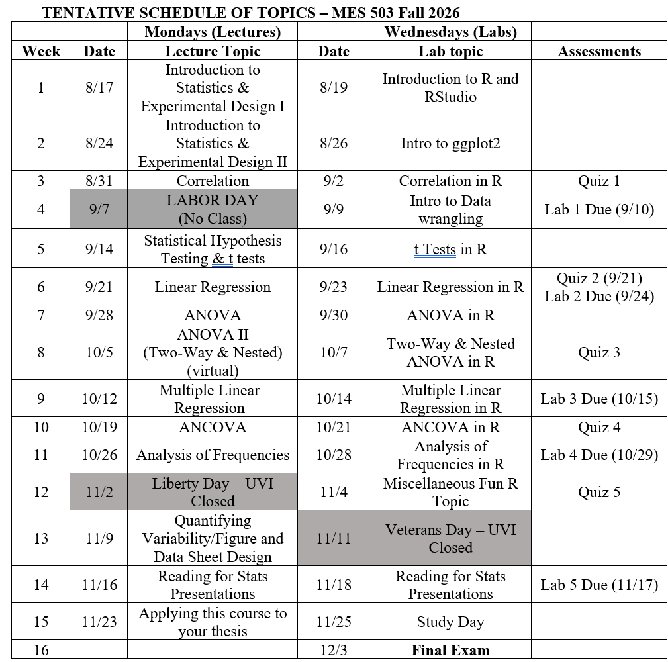
Announcements
Schedule Change
Answer Key for last week posted

Slide 3
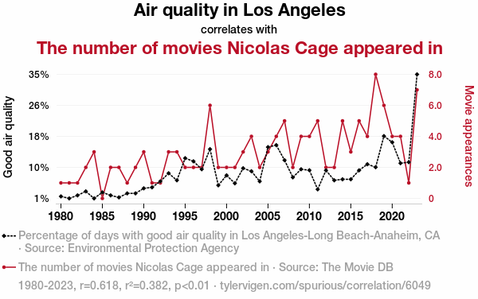
Spurious Correlations in the News!
Tell us what you found!

Slide 4


Organizing Ourselves
You’re in charge of R projects and organizing your lab materials now
Take some time to download/set up this week’s lab materials however you see fit (REMINDER: R Project instructions are on Brightspace)
GOAL: Future you should be grateful for past you

Slide 5
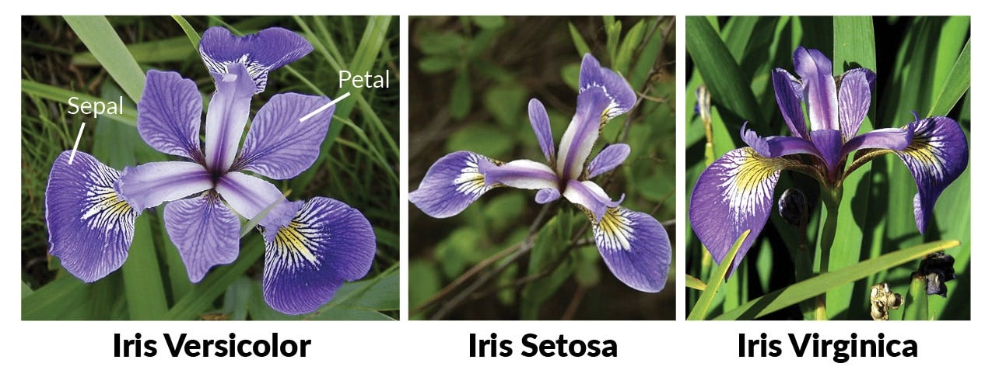
The data we’ll be looking at…

Slide 6
What type of plot do we typically use to display relationships between two continuous variables (i.e. correlations)?
The R Graph Gallery – Help and inspiration for R charts

Slide 7
Switch to ze code!

Slide 8
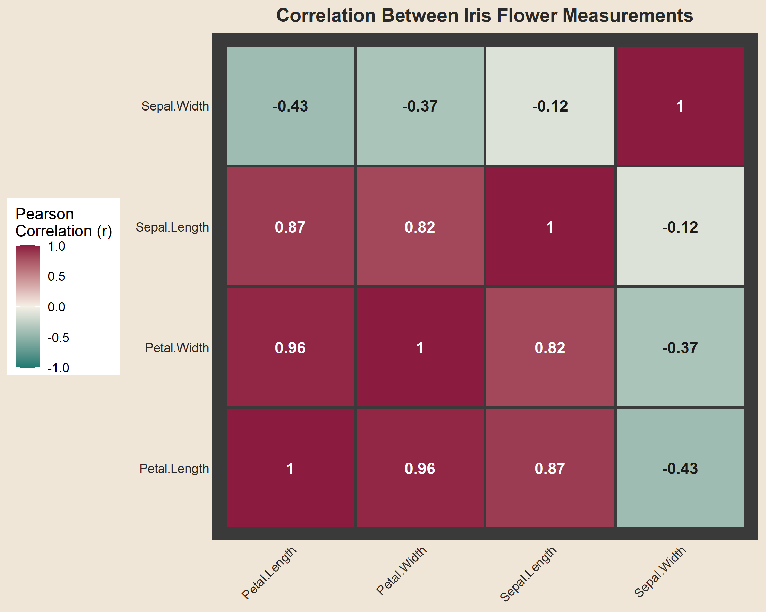

Slide 9
Additional Resources
Data visualization tips for clear communication | Geckoboard
The R Graph Gallery – Help and inspiration for R charts

